Slide 1
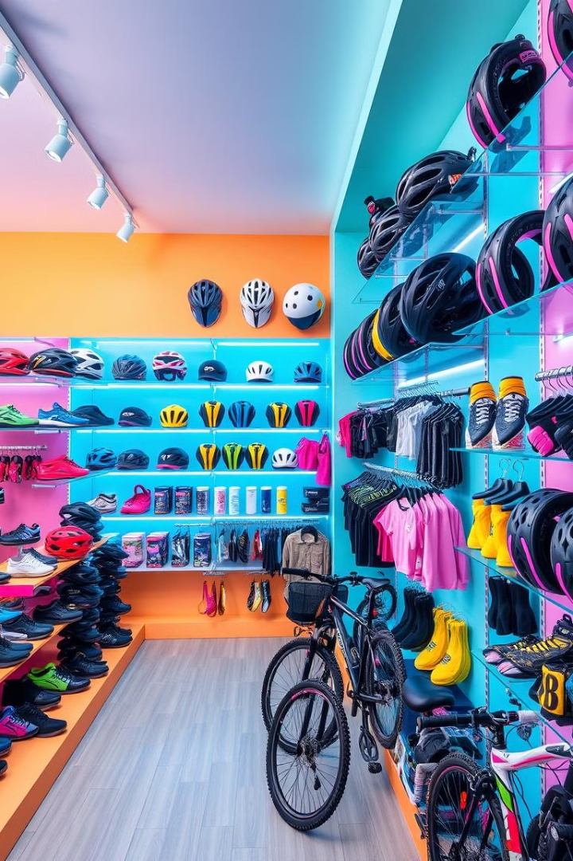
Case Study: Product Color Performance Analysis
VA
by Vaibhav Ahuja

Slide 2

Scenario
Company Overview: Adventure Works is a global sports cycle manufacturer operating in 10 countries.
Product Range: The company offers bicycles, accessories, components, and clothing.
Objective: Identify color-based performance trends across all product categories.
Business Impact: Insights will help determine the most and least profitable colors, guiding strategic production and marketing decisions.

Slide 3
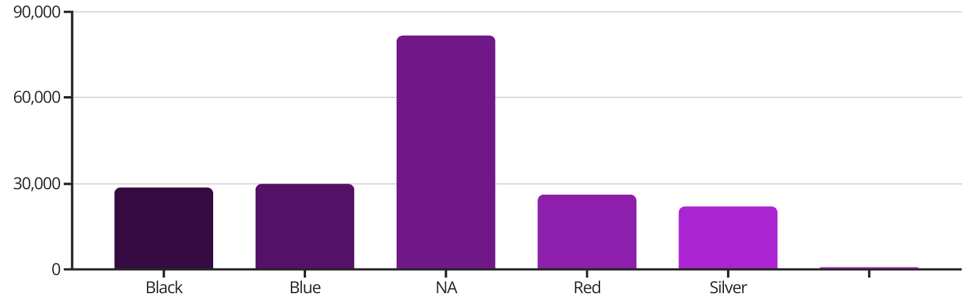
Accessories Color Performance
1
Standard Colors
2
Non-Colored Accessories
All colors yielded ₹20K–₹30K as total profit.
Non-colored accessories performed the best, generating ₹80K in profit.

Slide 4
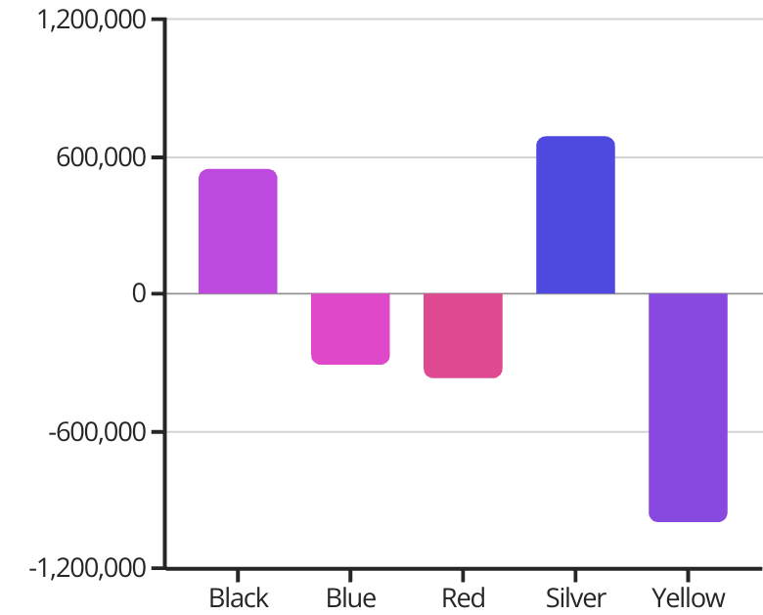
Bikes Color Performance
Yellow bikes recorded the highest losses of ₹997K, followed by Red (₹365K loss) and Blue (₹312K loss).
Silver and Black bikes were the most profitable, earning ₹550K and ₹689K, respectively.
Further analysis revealed that every Yellow bike model (23 products) incurred a loss.
6 out of 21 Red bike models were profitable, proving Yellow to be the worst-performing color for bikes.

Slide 5




Clothing Color Performance
Black Clothing Profit
1
Top performing color
Blue Clothing Profit
2
Second best performer
White Clothing Profit
3
Minimal profit
Yellow Clothing Loss
4
Worst performer

Slide 6
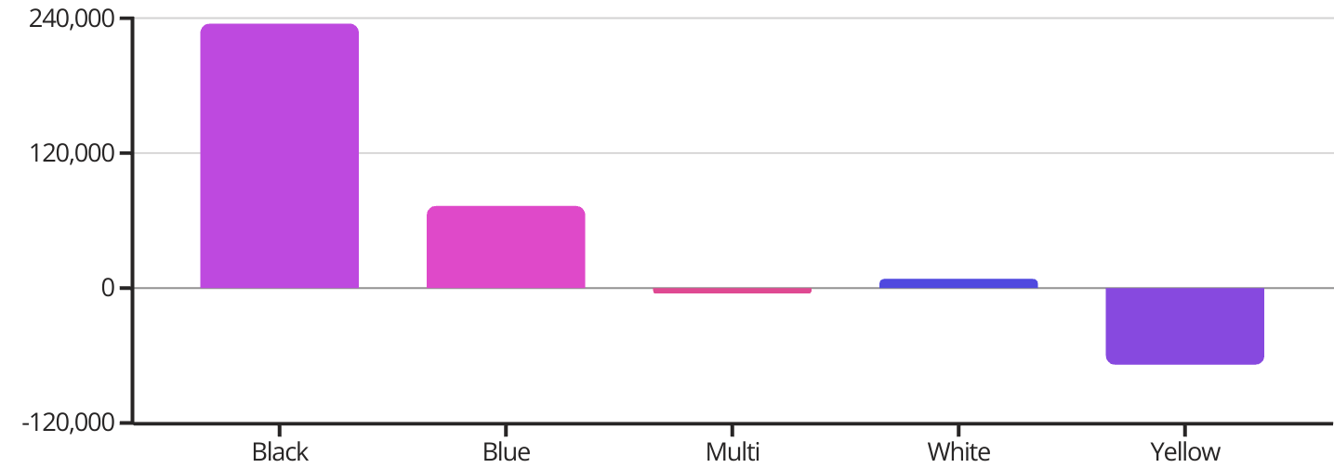
Clothing Profit Graph
Black was the top-performing color, contributing ₹235K in profit, followed by Blue at ₹74K.
White had minimal profit (₹8K), while Yellow (₹66K loss) and Multi-color (₹5K loss) performed poorly.

Slide 7





Components Color Performance
Silver (28%)
Black (48%)
2
Silver components followed at 28% of total profits
Black dominated, contributing 48% of total profit (₹1M)
1
Non-colored (10%)
3
Non-colored components accounted for 10% of profits
Blue
5
Other Colors (14%)
Blue components showed an unexpected loss of ₹1.8K
4
Red, Silver/Black and others made up the remaining profit

Slide 8
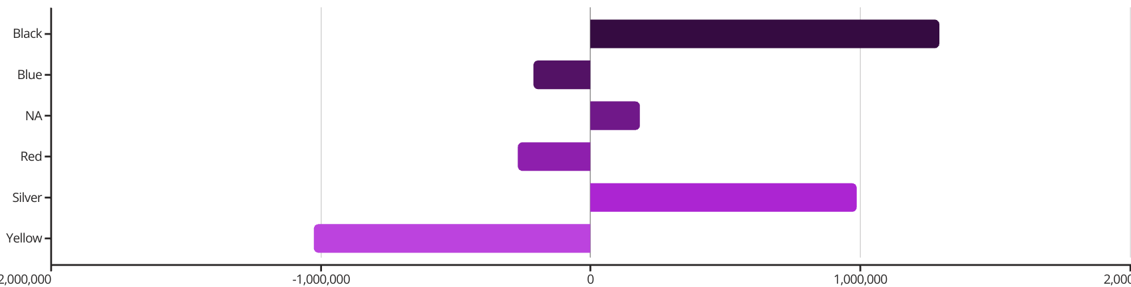




Overall Profit and Loss by Color
Black: ₹1.3M Profit
Silver: ₹988K Profit
Blue: Mixed Performance
Yellow: ₹1.06M Loss
Black led in overall profitability with ₹1.3M in total profits across all product categories
Silver followed with ₹988K in total profits, particularly strong in bikes
Profitable in clothing but losses in bikes
Yellow performed the worst, showing major losses in both Bikes (₹997K) and Clothing (₹67K)

Slide 9
Key Insights and Strategic Recommendations
1
Profit Erosion
2
Top Performers
50% of total profit was eroded by losses from Yellow bikes (₹997K loss)
The most profitable product variant was Silver bikes (₹689K profit). Silver bikes, Black clothing, and Black components proved to be highly profitable.
3
Underperformers
4
Marginal Performers
Yellow performed the worst across categories. Red and Blue bikes also underperformed, with a combined loss of ₹480K, but some Red models were profitable.
White and Silver/Black products showed only marginal profitability

Slide 10

Thank You
Thank you for taking the time to review this analysis. We hope these insights provide a solid foundation for strategic decision-making.
Vaibhav Ahuja

